Slide 1
Internal Task and Attendance Tracker System
Submitted by: Abrham Habtamu

Slide 2
1.Project Description
The "Internal Task and Attendance Tracker" is a secure web-based application designed to streamline task assignment, daily attendance monitoring, and progress tracking for interns and staff. It provides an efficient way for team leads and managers to allocate work, monitor task status, and generate attendance insights.
This system is especially useful for "internship management", "team productivity tracking", and "daily workflow coordination".

Slide 3
2. Objectives
Allow employees/interns to "check in and out" daily.
Enable managers to "assign tasks" and track task progress.
Provide real-time "dashboards" for both users and admins.
Enhance "organizational efficiency" and accountability.
Ensure "role-based access" and secure data management.

Slide 4
3.User Roles and Permissions
Admin (Manager, Supervisor)
Manage users
Assign & monitor tasks View attendance logs
View statistics dashboard
User (Intern, Employee)
Check in / check out
View personal attendance records
View and update assigned tasks

Slide 5
4. Key Features
Authentication & Authorization
Login/Logout
JWT-based security
Role-based routing (Admin/User)
Attendance Module
Daily check-in/check-out
View history with date, time, and IP/Device info (optional)
Admin view of attendance records by user/date

Slide 6
Task Management Module
Admin assigns tasks to users
Tasks include title, description, deadline, priority
Users can update task status: `Pending`, `In Progress`, `Completed`
Tasks visible in user dashboard
Dashboard & Reports
Admin:
Daily/weekly attendance summary
Task progress charts
Recent activity logs

Slide 7
User:
Today’s attendance status
Assigned tasks & deadlines
Task progress bar
User Profile Management
View/edit profile (basic info)
Change password
View own attendance & tasks

Slide 8
5. Pages and Components
Authentication
Login Page
Register Page (optional for admins only)
Admin Pages
Dashboard — overview stats (tasks, attendance)
Users Page — list of all users, search/filter
Attendance Logs — filterable by date/user
Task Manager — assign/view tasks
Reports — exportable summary (optional)

Slide 9
User Pages
User Dashboard — attendance + assigned tasks
Check-in/Check-out Page
My Tasks — with status update controls
Attendance History
Shared
Navbar
Sidebar (with role-based menu items)
Notifications (for task updates, check-in success, etc.)

Slide 10
6. Technology Stack
Frontend:
React.js + TypeScript
Tailwind CSS + shadcn/ui
Axios or Fetch for API requests
Zustand or Context API for state management

Slide 11
Backend:
Node.js + Express.js
MongoDB with Mongoose
JWT for authentication
Bcrypt for password hashing
Optional Tools:
Chart.js or Recharts (for dashboard visuals)
Multer (if file attachments are allowed for tasks)
Postman (for API testing)

Slide 12
7. Database Schema (Brief Overview)
User Model:
{
name,
email,
role, // 'admin' | 'user'
passwordHash,
createdAt
}

Slide 13
Task Model:
{
title,
description,
assignedTo (User ID),
status, // 'pending' | 'in-progress' | 'completed'
priority, // 'low', 'medium', 'high'
dueDate,
createdAt
}

Slide 14
Attendance Model:
{
userId,
date,
checkInTime,
checkOutTime,
deviceInfo (optional),
ipAddress (optional)
}

Slide 15
9. Final Deliverables
Fully functional web app (deployed locally or on cloud)
Documentation (README + DB Schema + Admin Guide)
Presentation slides
(Optional) GitHub repo with clean code and commit history

Slide 16
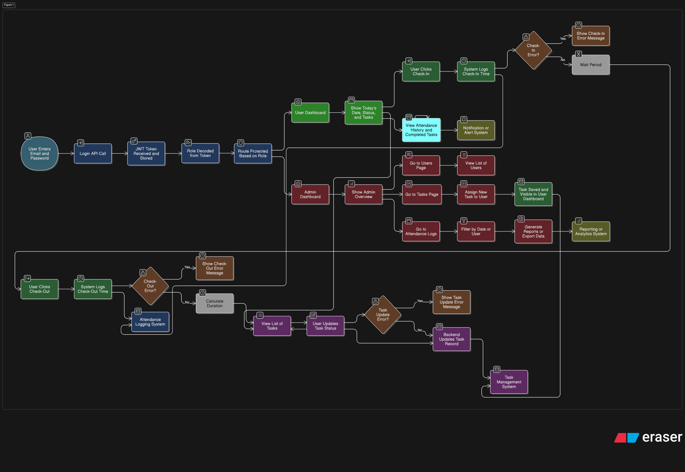
The flow chart diagram

